Slide 1
1. Transport Layer (TCP) 2. Network Attacks

Slide 2
Transmission Control Protocol
TCP is the transport layer protocol guaranteeing reliable data transfer, in-order delivery of messages and the ability to distinguish data for multiple concurrent applications on the same host
Most popular application protocols, including HTTP, FTP and SSH are built on top of TCP
Delivery order is maintained by marking each packet with a sequence number
Every time TCP receives a packet, it sends out an ACK to indicate successful receipt of the packet.
TCP generally checks data transmitted by comparing a checksum of the data with a checksum encoded in the packet

Slide 3
TCP Basics
Cumulative acknowledgements
An acknowledgement ack’s all contiguously received data
TCP assigns byte sequence numbers

Slide 4
Reliable Byte-Stream Service
Stream Data Transfer
transfers a contiguous stream of bytes across the network, with no indication of boundaries
groups bytes into segments
transmits segments as convenient (Push function defined)
Reliability
error control mechanism to deal with IP transfer impairments
Write 45 bytes
Write 15 bytes
Write 20 bytes
Application
Read 40 bytes
Read 40 bytes
Transport
segments
Error Detection & Retransmission
buffer
buffer
ACKS, sequence #

Slide 5
Cumulative Acknowledgements
A new cumulative acknowledgement is generated only on receipt of a new in-sequence packet
40
39
38
37
33
34
35
36
41
40
39
38
34
35
36
37
i
data
i
ack

Slide 6
Duplicate Acknowledgements
A dupack is generated whenever an out-of-order segment arrives at the receiver
40
39
38
37
34
36
42
41
40
39
36
36
Dupack
On receipt of 38
(Above example assumes delayed acks)

Slide 7
Duplicate Acknowledgements
Duplicate acks are not delayed
Duplicate acks may be generated when
a packet is lost, or
a packet is delivered out-of-order (OOO)
40
39
37
38
34
36
41
40
39
37
36
36
Dupack
On receipt of 38

Slide 8
Flow Control
Buffer limitations & speed mismatch can result in loss of data that arrives at destination
Receiver controls rate at which sender transmits to prevent buffer overflow
Application
Transport
segments
buffer used
buffer
advertised
window size < B
buffer available = B

Slide 9
TCP Segment Format
0 4 8 16 24 31
Source port Destination port
Sequence number
Acknowledgment number
Header
CWR
ECE
U
A
P
R
S
F
length
Reserved
R
C
S
S
Y
I
Window size
G
K
H
T
N
N
Checksum Urgent pointer
Options Padding
Data
Each TCP segment has header of 20 or more bytes + 0 or more bytes of data

Slide 10
TCP Header
Port Numbers
A socket identifies a connection endpoint
IP address + port
A connection specified by a socket pair
Well-known ports
FTP 20
Telnet 23
DNS 53
HTTP 80
Sequence Number
Byte count
First byte in segment
32 bits long
0 ≤ SN ≤ 2³²-1
Initial sequence number selected during connection setup

Slide 11
TCP Header
Window Size
16 bits to advertise window size
Used for flow control
Sender will accept bytes with SN from ACK to ACK + window
Maximum window size is 65535 bytes
TCP Checksum
Internet checksum method
TCP pseudoheader + TCP segment

Slide 12
Initial Sequence Number
Select initial sequence numbers (ISN) to protect against segments from prior connections (that may circulate in the network and arrive at a much later time)
Select ISN to avoid overlap with sequence numbers of prior connections
Use local clock to select ISN sequence number
Time for clock to go through a full cycle should be greater than the maximum lifetime of a segment (MSL); Typically MSL=120 seconds
High bandwidth connections pose a problem
2^{n} > 2 * max packet life * R bytes/second

Slide 13
TCP Connection Establishment
Three-way Handshake
ISN’s protect against segments from prior connections
Host A
Host B
SYN, Seq_no = x
SYN, Seq_no = y, ACK, Ack_no = x+1
Seq_no = x+1, ACK, Ack_no = y+1

Slide 14
Ports
TCP supports multiple concurrent applications on the same server; Header both a source and a destination port
In most cases, both TCP and UDP use the same port numbers for the same applications
Ports 0 through 1023 are reserved for use by known protocols.
Ports 1024 through 49151 are known as user ports, and should be used by most user programs for listening to connections and the like
Ports 49152 through 65535 are private ports used for dynamic allocation by socket libraries

Slide 15
Modification and Fabrication
Data corruption
May be intentional or unintentional, malicious or nonmalicious, directed or random
Sequencing
Permuting the order of data, such as packets arriving in sequence
Substitution
Replacement of one piece of a data stream with another
Insertion
A form of substitution in which data values are inserted into a stream
Replay
Legitimate data are intercepted and reused

Slide 16
Sources of Data Corruption

Slide 17
IP Vulnerabilities
If Unencrypted transmission
Eavesdropping possible at any intermediate host during routing
No source authentication
Sender can spoof source address, making it difficult to trace packet back to attacker
No integrity checking
Entire packet, header and payload, can be modified while en route to destination, enabling content forgeries, redirections, and man-in-the-middle attacks
No bandwidth constraints
Large number of packets can be injected into network to launch a denial-of-service attack
Broadcast addresses provide additional leverage

Slide 18
Denial of Service (DoS) Attack
Bandwidth is finite on any network and so infinite number of connection cannot be accepted by a server.
When a server has used up its bandwidth or the ability of its processors to respond to requests, then additional attempted connections are dropped.
Any attack designed to cause a machine or software to be unavailable and unable to perform its basic functionality is known as DoS attack.
Further, the attackers are not concerned with receiving any responses from a target, so IP spoofing to obscure identity of the attacker can be used. (Mitigation attempts also fail)
Blacklisting may be a solution but not of much use
Attacker may choose to generate a unique source IP address for every packet sent, preventing target from successfully identifying and blocking the attacker.

Slide 19
DoS Attack …
Send large number of packets to host providing service
Slows down or crashes host
Often executed by botnet
Attack propagation
Starts at zombies
Travels through tree of Internet routers rooted
Ends at victim
IP source spoofing
Hides attacker
Scatters return traffic from victim

Slide 20
Man-in-the-Middle (MITM)
Attacker is able to listen and intercept messages between two communication parties
Attacker then creates separate connections between the two victims and communicates with them

Slide 21
Countermeasures to DoS attacks
Local DoS attacks
Partition disks
Disk quotas
Set process limits
Monitor system activity/CPU/Disk Usage
Physical Security
AntiVirus/AntiSpam/AntiMalware

Slide 22
Network Based DoS Attacks
UDP Bombing
TCP SYN flooding
PING of death
Smurf attack
Most involve either resource exhaustion or corruption of the operating system runtime environment

Slide 23
ICMP Attacks
Ping of death
ICMP specifies messages must fit a single IP packet (64KB)
Send a ping packet that exceeds maximum size using IP fragmentation
Reassembled packet caused several operating systems to crash due to a buffer overflow
Ping packets may also saturate the victim’s bandwidth

Slide 24

Smurf Attack
Smurf
Variant of ping attack
Ping a broadcast address using a spoofed source address
Amplifying
Network
echo response
echo request
echo response
Attacker
Victim
echo response
Target

Slide 25

Etymology

Slide 26
Reconnaissance
A clever attacker investigates and plans before acting.
A network attacker learns a lot about a potential target before beginning the attack.

Slide 27
Reconnaissance (Cont’d): Port Scan
A program that, for a particular IP address, reports which ports respond to messages and which of several known vulnerabilities seem to be present.
Port scanning tells an attacker three things:
which standard ports or services are running and responding on the target system,
what operating system is installed on the target system
what applications and versions of applications are present.

Slide 28
Reconnaissance (Cont’d): Social Engineering
The port scan gives an external picture of a network
Social engineering involves using social skills and personal interaction to get someone to reveal security-relevant information and perhaps even to do something that permits an attack.
Because the victim has helped the attacker (and the attacker has profusely thanked the victim), the victim will think nothing is wrong and not report the incident.

Slide 29
Reconnaissance (Cont’d): Intelligence
From a port scan the attacker knows what is open.
From social engineering, the attacker knows certain internal details.

Slide 30
Reconnaissance (Cont’d): Operating System and Application Fingerprinting
The port scan supplies the attacker with very specific information.
The attacker is likely to have many related questions, such as which commercial server application is running, what version, and what the underlying operating system and version are.
A new version will implement a new feature but an old version will reject the request.
The operating system or application fingerprint, can mark the manufacturer and version.

Slide 31
Threats in Transit: Eavesdropping and Wiretapping
The term eavesdrop implies overhearing without expending any extra effort.
Passive wiretapping means "listening," much like eavesdropping.
But active wiretapping means injecting something into the communication.

Slide 32
Impersonation
Guess the identity and authentication details of the target.
Pick up the identity and authentication details of the target from a previous communication or from wiretapping.
Circumvent or disable the authentication mechanism at the target computer.
Use a target that will not be authenticated.
Use a target whose authentication data are known.

Slide 33
Impersonation (Cont’d)
Authentication Foiled by Guessing
Easy-to-guess passwords.
Default passwords.
Dead accounts offer a final source of guessable passwords.
Authentication Thwarted by Eavesdropping or Wiretapping
Authentication Foiled by Avoidance
A weak or flawed authentication allows access to any system or person who can circumvent the authentication.

Slide 34
Impersonation (Cont’d)
Nonexistent Authentication
If two computers are used by the same users to store data and run processes and if each has authenticated its users on first access, you might assume that computer-to-computer or local user-to-remote process authentication is unnecessary.
Well-Known Authentication
Authentication data should be unique and difficult to guess.

Slide 35
Impersonation (Cont’d)
Trusted Authentication
Authentication can become a problem when identification is delegated to other trusted sources.
Spoofing
an attacker falsely carries on one end of a networked interchange.
Masquerade
One host pretends to be another.
A common example is URL confusion. E.g., xyz.com, xyz.org, and xyz.net might be three different organizations
Spear Phishing. You send an e-mail message, perhaps with the real logo of Blue Bank, and an enticement to click on a link, supposedly to take the victim to the Blue Bank web site.
Session Hijacking
MITM

Slide 36
IP Traceback
R
R
A
R
R
R
R₇
R
R₄
R₅
R₆
R
R₃
R₁
R₂
V
Notes:
Find an attack graph
Routers record packet forwarding events.
Victim walks the network in reverse order querying routers

Slide 37
IP Traceback
Problem
How to identify leaves of DoS propagation tree?
Routers next to attacker?
Issues
There are more than 2M internet routers
Attacker can spoof source address
Attacker knows that traceback is being performed
Approaches
Filtering and tracing (immediate reaction)
Messaging (additional traffic)
Logging (additional storage)
Probabilistic marking

Slide 38
Logging Challenges in IP Traceback
Logging each packet forwarded by each router
Attack path reconstruction is difficult
Packet may be transformed as it moves through the network
Full packet storage is problematic at routers
Memory requirements are prohibitive at high line speeds (OC-192 is ~10Mpkt/sec)
Extensive packet logs are a privacy risk
Traffic repositories may aid eavesdroppers

Slide 39
Probabilistic Packet Marking
Method called Node Sampling
Random injection of information into packet header related to the path that packet has taken up to that point
Each router writes this field of each packet with its own address with some probability
Changes seldom used bits
Redundancy to survive packet losses
To reconstruct the path, the victim can use these marked packets

Slide 40
Probabilistic Packet Marking
Benefits
No additional traffic
No router storage
No packet size increase
Can be performed online or offline
However, widespread cooperation from Internet routers is needed for its implementation
ICMP may also be used to relay path information
IPsec though seems better as it verifies origin of the packets by requiring cryptographic authentication

Slide 41
SYN Flood
Rely on sending TCP connection requests faster than the server can process them
Attacker creates a large number of packets with spoofed source addresses and setting the SYN flag
Receiver maintains a queue called SYN_RECV tracking the connection establishment
The server responds with a SYN/ACK for which it never gets a response (waits for about 3 minutes each)

Slide 42
SYN Flood
Eventually the server stops accepting connection requests, thus triggering a denial of service.
Solution – SYN Cookies
(Don’t drop connection because the memory is filled)
Sequence number negotiated at connection setup
Do not maintain state (i.e. in connection table) after SYN receipt at the server
Encode cipher in sequence number from server to client
Client must reflect it ⇒ check integrity; if okay, generate state from ACK

Slide 43
Port Knocking
Broadly port knocking is the act of attempting to make connections to blocked ports in a certain order in an attempt to open a port
Port knocking is fairly secure against brute force attacks since there are 65536^{k} combinations, where k is the number of ports knocked
Port knocking however if very susceptible to replay attacks.
Someone can theoretically record port knocking attempts and repeat those to get the same open port again
One good way of protecting against replay attacks would be a time dependent knock sequence.

Slide 44
Port knocking working
Client wants to connect to port n on server, port n on server is blocked
Client tries to connect to ports a, b, c and d, not receiving any response while doing so, since the firewall blocks all responses
A port knocking daemon on the server keeps track of all the attempts
Once the correct knocking sequence is received it opens port n.

Slide 45
Port Scanning Methods
SYN – Half Open (Send either SYNACK or if target is just only alive, it will send RST
FIN – Target listening to a port will not respond. Otherwise send RST
XMAS – Send a TCP packet with flags FIN, URG, PSH set to a port. Not listening target will not respond otherwise will send RST
NULL – TCP packet sent with all flags turned off. If target is listening to a particular port, will not respond. Otherwise, the target will send RST.
RPC – NULL commands to open ports to find if RPC is working
IP Packets – Different protocol packets sent
ACK – Send ACK, the target sends RST or does not send anything / or sends ICMP unreachable (checks firewall rules are set or not)
UDP Port check and Window check

Slide 46
SYN Cookies
Instead of allocating space on the connection table, the sequence number on the SYN/ACK packet is a carefully calculated hash of the connection requestors details, and when the server receives a response (ACK) it adds the connection to the connection table after verifying information in the cookie.
Easy to create and validate, hard to forge
Includes timestamp, nonce, 4-tuple

Slide 47
SYN Cookies
TCP Sequence Number is encoded in SYN/ACK
5 bit timestamp calculated as time mod 32
Counter to ensure sequence numbers increase every 64 seconds
Next 3 bits encoded value representing the MSS of transmission (eight values only)
24 bit MAC of server and client socket and previously used timestamp computed using a secret key
Only requires changes at the server
See http://cr.yp.to/syncookies.html for details (how to activate in Linux, ..)
32
0
t mod 32
MSS
Cookie=HMAC(t, N_{s}, SIP, SPort, DIP, DPort)
5 bits
3 bits

Slide 48
Optimistic TCP ACK Attack
Ws = min {Advertised Window, cwnd}, cwnd reflects estimated bandwidth available and gets varied depending upon the ACKs received from other end
The sliding window behaviour of TCP controls the packets to be transmitted – new segments or the segments to be retransmitted when corresponding ACKs are not received
Congestion control nature of TCP automatically adjusts as network conditions change
An optimistic TCP ACK attack takes advantage of the TCP congestion control
It is a DoS attack that makes the congestion control mechanism of TCP work against itself

Slide 49
Optimistic ACK Attack …
In this attack, a rogue client tries to make a server increase its sending rate until it runs of bandwidth and cannot effectively serve anyone else.
It begins with a client sending out ACKs for data segments it is yet to receive i.e. acknowledge “in-flight” packets
This flood of optimistic ACKs makes the server TCP program believe that there is a large amount of bandwidth available and thus, increase cwnd and therefore, its transmission speed

Slide 50
Optimistic ACK Attack …
This leads to the attacker providing more optimistic ACKs, and eventually bandwidth use beyond what the server has available
This can also be played out across multiple servers, with enough congestion that a certain section of the network is no longer reachable
If performed simultaneously against many servers, this attack can also create Internet-wide congestion by overwhelming the bandwidth of routers between the victims and attacker
Solution: 1. Implement maximum traffic limits per client
2. Block traffic from clients whose traffic patterns indicate DoS attempts (So, mitigation is not difficult at all)

Slide 51
IP Spoofing
IP Spoofing is an attempt by an intruder to send packets from an IP address that appear to originate at another
Source IP Address is forged intended to fool a host into accepting bogus data
If the server thinks it is receiving messages from the real source after authenticating a session, it could inadvertently behave maliciously
There are two basic forms of IP Spoofing
Blind Spoofing
Attack from any source
Non-Blind Spoofing
Attack from the same subnet

Slide 52
Blind IP Spoofing
TCP requires that “acknowledgement” numbers be sent across sessions
Makes sure that the client is getting the server’s packets and vice versa
Need to have the right sequence of acknowledgment numbers to spoof an IP identity
Used to be that programs such as rlogin used extremely predictable patterns of acknowledgment numbers
Simply by sending packets to the server and getting responses, one could decode the pattern of acknowledgment numbers
Once an intruder had the acknowledgment number algorithm, it was a simple matter of sending packets with the correct numbers to spoof a client
Most modern systems make acknowledgment sequences random so that this may not be done

Slide 53
Non-Blind IP Spoofing
IP Spoofing without inherently knowing the acknowledgment sequence pattern
Done on the same subnet
Use a packet sniffer to analyze the sequence pattern
Packet sniffers intercept network packets
Eventually decodes and analyzes the packets sent across the network
Determine the acknowledgment sequence pattern from the packets
Send messages to server with actual client's IP address and with validly sequenced acknowledgment number

Slide 54
Undermining Unix r-commands via IP Address Spoofing
When one Unix system trusts another, a user can log into the trusted machine and then access the trusting machine without supplying a password by using rlogin, rsh, and rcp
hosts.equiv or .rhosts files used to implement trusts
IP address of trusted system used as weak form of authentication
Attacker spoofing IP address of trusted system can connect to trusting system without providing password
“Rbone” tool http://packetstorm.security.com

Slide 55
Spoofing Attack against Unix Trust Relationships
Attacker interacts with targeted trusting server to determine predictability of initial sequence number
Attacker launches a denial-of-service attack (eg. SYN flood or smurf attack) against trusted system to force it not to respond to a spoofed TCP connection
Attacker rsh to targeted trusting server using spoofed IP address of trusted server
Trusting server sends an SYN-ACK packet to the unresponsive trusted server
Attacker sends an ACK packet to trusting server with a guess at the sequence number. If ISN is correct, a connection is made.
Although attacker cannot initially see reply packets from trusting server, attacker can issue command to append “++” to hosts.equiv or .rhosts file. Trusting server will now trust all machines. IP spoofing is no longer needed

Slide 56
Spoofing with Source Routing
Works if routers support source routing
Attacker generates TCP SYN packet destined for trusting server containing spoofed IP address of trusted machine and fake source route in IP header
Trusting server will reply with a SYN-ACK packet containing a source route from trusting server to attacker to trusted machine.
Attacker receives the reply but does not forward it to the trusted machine.
Attacker can pose as trusted machine and have interactive sessions with trusting machine

Slide 57
IP Spoofing Defenses
Make sure that initial sequence numbers generated by TCP stacks are difficult to predict
Apply latest set of security patches from OS vendor
Used nmap to verify predictability of ISN
Use ssh instead of r-commands
Avoid applications that use IP addresses for authentication
Authentication should use passwords, PKI, or Kerberos or other methods that tie a session back to a user.
Use “anti-spoof” packet filters at border routers and firewalls
ingress (incoming) and egress (outgoing) filters
Block source-routed packets on routers
“no ip sourceroute”

Slide 58
Session Hijacking
Also commonly known as TCP Session Hijacking
A security attack over a protected network
Attempt to take control of a network session
Sessions are server keeping state of a client’s connection
Servers need to keep track of messages sent between client and the server and their respective actions
Most networks follow the TCP/IP protocol and IP Spoofing is one type of hijacking on large network

Slide 59
Categories of TCP Session Hijacking
Based on the anticipation of sequence numbers there are two types of TCP hijacking:
Man-in-the-middle (MITM)
Blind Hijack

Slide 60
Session Hijacking
Attack based on sniffing and spoofing
Occurs when attacker steals user session such as telnet, rlogin, or ftp.
Innocent user thinks that his session was lost, not stolen
Attacker sits on a network segment where traffic between victim and server can be observed
Attacker injects spoofed packets contain source IP address of victim with proper TCP sequence numbers (note: blind injection)
If hijack is successful, the server will obey all commands sent by attacker.
May cause ACK storm between victim and server when victim tries to resynchronize its sequence number

Slide 61
Host-based Session Hijacking
Attacker can hijack a session on source or destination machine if he has super user privileges on that machine
Highjacking tool allows attacker to interact with the local terminal devices (tty)
Attacker can read all session information from victim’s tty
Attacker can control victim’s tty by injecting keystrokes into the tty
Host-based session hijacking preferable to network-based session hijacking if target machine is already compromised

Slide 62
Session Hijacking Tools
Network-based
Hunt http://www.cri.cz/kra/index.html
Dsniff’s sshmitm tool in –I mode
Juggernaut http://packetstorm.securify.com
Host-based
TTYWatcher http://ftp.cerias.purdue.edu/pub/tools/unix/sysutils
TTYSnoop http://packetstorm.securify.com

Slide 63
Session Hijacking with Hunt
Runs on Linux platform
Allows attacker to see many sessions going across the network and to hijack a particular session
ACK storm may occur after the attacker injects one or two commands
ACK storm can be prevented running Hunt in a mode supporting ARP spoofing
Don’t want victim’s packets to be seen by server and visa versa
Attacker sends bogus ARP replies to both victim and server to poison their ARP tables
Attacker sees traffic sent by victim and server
Hunt can resynchronize the connection so session can be returned to victim
Message is sent to victim to type certain number of keys to increment victim’s sequence number

Slide 64
Session Hijacking Defenses / Countermeasures
Use SSH or VPN for securing sessions
Attackers will not have the keys to encrypt or decrypt traffic (Network Layer / Application Layer)
Pay attention to warning messages about any change of public key on server since this may be a person-in-the-middle attack
Web sites should avoid creating sessions that begin with secure server authentication measures but subsequently switch over to unencrypted exchanges
Tradeoff??

Slide 65
Packet Sniffers
Packet sniffers “read” information traversing a network
Packet sniffers intercept network packets, possibly using ARP cache poisoning
Can be used as legitimate tools to analyze a network
Monitor network usage
Filter network traffic
Analyze network problems
Can also be used maliciously
Steal information (i.e. passwords, conversations, etc.)
Analyze network information to prepare an attack
Packet sniffers can be either software or hardware based
Sniffers are dependent on network setup

Slide 66
Man in the Middle Attack Using Packet Sniffers
This technique involves using a packet sniffer to intercept the communication between client and the server.
Packet sniffer comes in two categories:
Active sniffers
Passive sniffers.

Slide 67
Passive Sniffers
Passive sniffers monitors and sniffs packet from a network having same collision Domain i.e. network with a hub, as all packets are broadcasted on each port of hub.

Slide 68
Passive Sniffers
Sniffers that passively wait for traffic to be sent to them
Well suited for hub environment
Snort
Sniffit

Slide 69
Active Sniffers
One way of doing so is to change the default gateway of the client’s machine so that it will route its packets via the hijacker’s machine.
This can be done by ARP spoofing (i.e. by sending malicious ARP packets mapping its MAC address to the default gateways address so as to update the ARP cache on the client , to redirect the traffic to hijacker).

Slide 70
Tools used in Network Attacks
Sniffing
Spoofing
Session hijacking
Netcat

Slide 71
Sniffer
Allows attacker to see everything sent across the network, including userIDs and passwords
NIC placed in promiscuous mode
Tcpdump http://www.tcpdump.org
Windump http://netgroup-serv.polito.it/windump
Snort http://www.snort.org
Ethereal http://www.ethereal.com
Sniffit http://reptile.rug.ac.be/~coder/sniffit/sniffit.html
Dsniff http://www.monkey.org/~dugsong/dsniff

Slide 72
Island Hopping Attack
Attacker initially takes over a machine via some exploit
Attacker installs a sniffer to capture userIDs and passwords to take over other machines

Slide 73
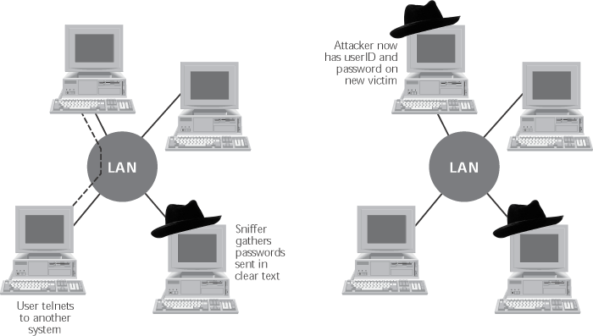
Figure 8.1 An island hopping attack

Slide 74
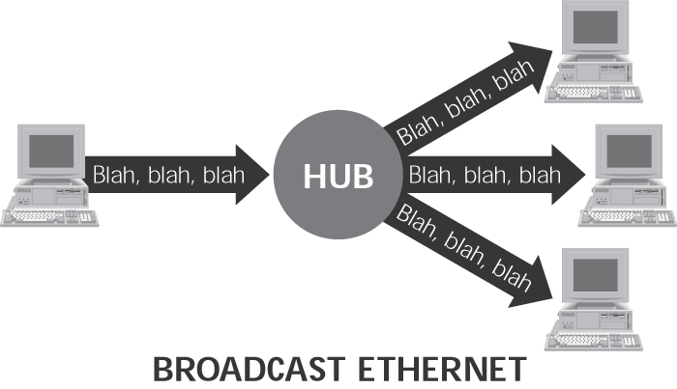
Figure 8.2 A LAN implemented with a hub

Slide 75
Sniffit in Interactive Mode
Useful for monitoring session-oriented applications such as telnet, rlogin, and ftp
Activated by starting sniffit with “-i” option
Sorts packets into sessions based on IP addresses and port numbers
Identifies userIDs and passwords
Allows attacker to watch keystrokes of victim in real time.
http://reptile.rug.ac.be/~coder/sniffit/sniffit.html

Slide 76
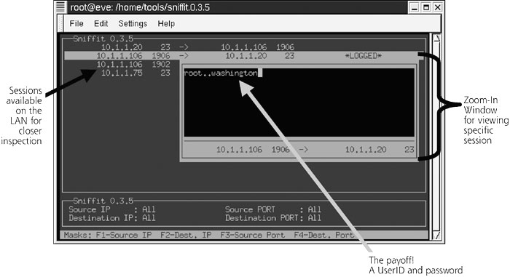
Figure 8.3 Using Sniffit in interactive mode to sniff a userID and password

Slide 77
Switched Ethernet LANs
Forwards network packets based on the destination MAC address in the Ethernet header
Renders passive sniffers ineffective

Slide 78
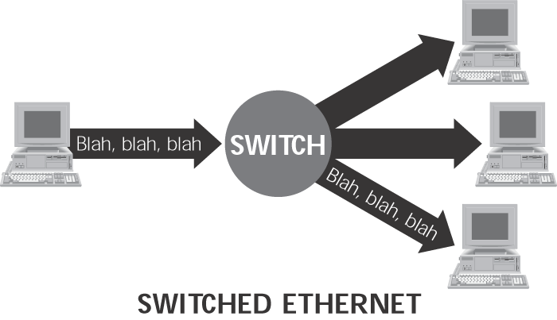
Figure 8.4 A LAN implemented with a switch

Slide 79
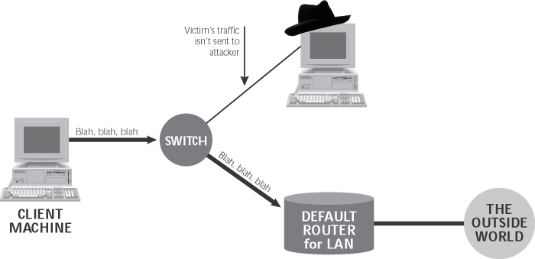
Figure 8.5 A switched LAN prevents an attacker from passively sniffing traffic

Slide 80
Dsniff
Active sniffer
http://www.monkey.org/~dugsong/dsniff
Runs on Linux, Solaris, OpenBSD
Excels at decoding a large number of Application level protocols
FTP, telnet, SMTP, HTTP, POP, NTTP, IMAP, SNMP, LDAP, Rlogin, RIP, OSPF, NFS, NIS, SOCKS, X11, IRC, ICQ, Napster, MS SMB, and SQL
Performs active sniffing using MAC flooding or arpspoof

Slide 81
Dsniff’s MAC Flooding
Initiated via Dsniff’s Macof program
Foul up switches by sending out a flood of packets with random MAC addresses
When switch’s memory becomes full, the switch will start forwarding data to all links on the switch
At this point, Dsniff or any passive sniffer can capture desired packets

Slide 82
Dsniff’s Arpspoof
Used in switched environment where MAC flooding does not work
DEFEATS switches via spoofed ARP messages
Attacker’s machine initially configured with “IP forwarding” to forward incoming network traffic to a default router
Dsniff’s arpspoof program activated to send fake ARP replies to the victim’s machine to poison its ARP table
Attacker can now sniff all traffic on the LAN

Slide 83
Dsniff’s DNSspoof
redirects traffic by sending false DNS information to victim
Attacker initially activates arpspoof and dnsspoof
When victim tries to browse a web site, a DNS query is sent but the attacker sends a poisoned DNS response
Victim unknowingly communicates with another web server

Slide 84
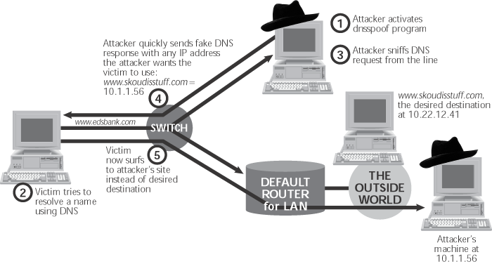
DNS attack using Dsniff

Slide 85
Sniffing HTTPS and SSH
Security is built on a trust model of underlying public keys
HTTPS server sends to browser a certificate containing server’s public key signed by a Certificate Authority
SSL connection uses a shared session key generated by client to encrypt data between server and client
With SSH, an encrypted session key is transmitted by client using server’s public key
Dsniff takes advantage of poor trust decisions made by a clueless user via man-in-the middle attack
Web browser user may trust a certificate that is not signed by a trusted party
SSH user can still connect to server whose key has changed

Slide 86
Attacking HTTPS and SSH via Dsniff
Webmitm
Sshmitm

Slide 87
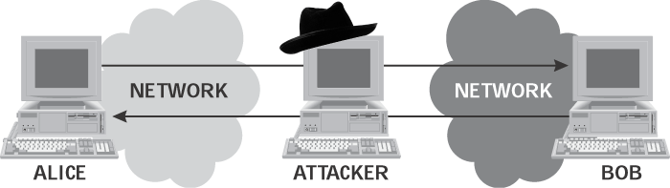
Figure 8.8 In a person-in-the-middle attack, the attacker can grab or alter traffic between Alice and Bob

Slide 88
Dsniff’s Webmitm
Program used to proxy all HTTP and HTTPS traffic
acting as an SSL proxy, webmitm can establish two separate SSL connections
One connection between victim and attacker
One connection between attacker and web server
Webmitm sends attacker’s certificate to victim

Slide 89
Detecting Sniffers
Sniffers are almost always passive
They simply collect data
They do not attempt “entry” to “steal” data
This can make them extremely hard to detect
Most detection methods require suspicion that sniffing is occurring
Then some sort of “ping” of the sniffer is necessary
It should be a broadcast that will cause a response only from a sniffer
Another solution on switched hubs is ARP watch
An ARP watch monitors the ARP cache for duplicate entries of a machine
If such duplicates appear, raise an alarm
Problem: false alarms
Specifically, DHCP networks can have multiple entires for a single machine

Slide 90
Stopping Packet Sniffing
The best way is to encrypt packets securely
Sniffers can capture the packets, but they are meaningless
Capturing a packet is useless if it just reads as garbage
SSH is also a much more secure method of connection
Private/Public key pairs makes sniffing virtually useless
On switched networks, almost all attacks will be via ARP spoofing
Add machines to a permanent store in the cache
This store cannot be modified via a broadcast reply
Thus, a sniffer cannot redirect an address to itself

Slide 91
Sniffing Defenses
Use HTTPS for encrypted web traffic
Use SSH for encrypted login sessions
Avoid using Telnet
Use S/MIME or PGP for encrypted email
Pay attention to warning messages on your browser and SSH client
Configuring Ethernet switch with MAC address of machine using that port to prevent MAC flooding and arp-spoofing
Use static ARP tables on the end systems

Slide 92
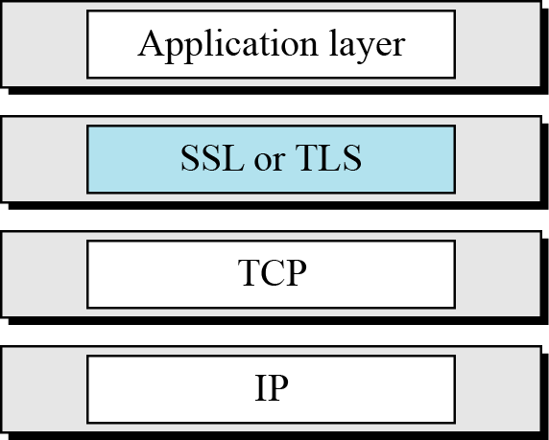
SSL and TLS in the Internet model

Slide 93
SSL ARCHITECTURE
SSL is designed to provide security and compression services to data generated from the application layer.

Slide 94
SSL (Secure Socket Layer)
Most widely used web security mechanism
Transport layer security service
Originally developed by Netscape
Ver3 designed with public input
Subsequently, became internet standard known as TLS (transport layer security)
Uses TCP to provide a reliable end-to-end service
SSL has two layers of protocols
Notes:
SSL probably most widely used Web security mechanism. Its implemented at the Transport layer; cf IPSec at Network layer; or various Application layer mechanisms eg. S/MIME & SET (later).

Slide 95
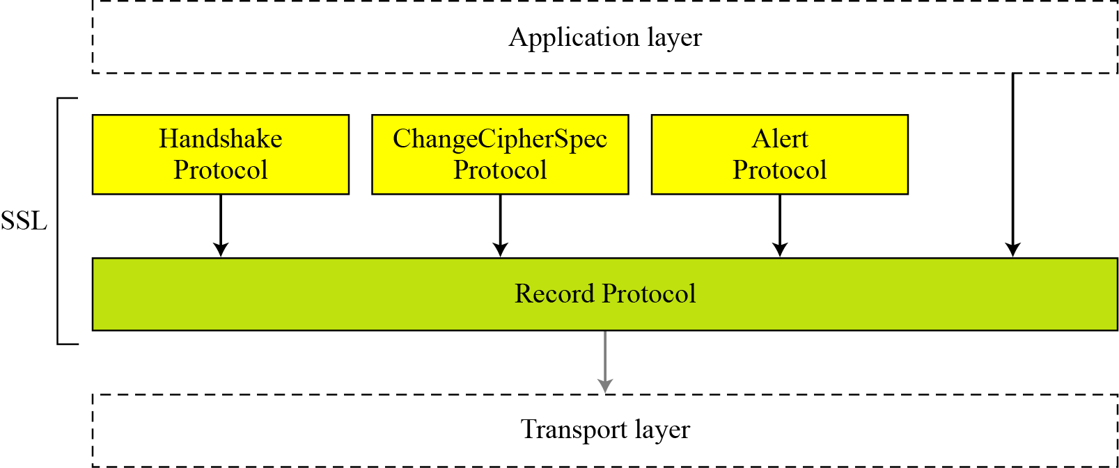
SSL Protocols

Slide 96
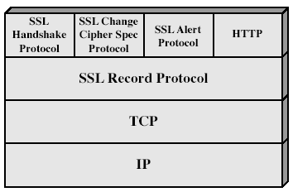
SSL Architecture
Notes:
Stallings Fig 17-2.

Slide 97
SSL Architecture
SSL session
An association between client & server
Created by the handshake protocol
Define a set of cryptographic parameters
May be shared by multiple SSL connections
SSL connection
A transient, peer-to-peer, communications link
Associated with 1 SSL session

Slide 98
SSL Record Protocol – Services
Confidentiality
Using symmetric encryption with a shared secret key defined by handshake protocol
IDEA, RC2-40, DES-40, DES, 3DES, RC4-40, RC4-128
Message is compressed before encryption
Message integrity
Using a MAC with shared secret key
Similar to HMAC but with different padding
Notes:
SSL Record Protocol defines these two services for SSL connections.

Slide 99
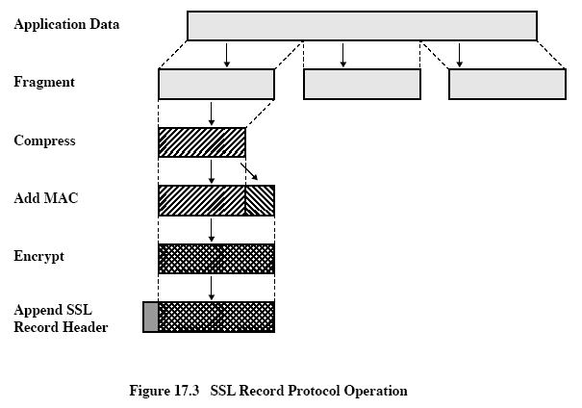

Slide 100
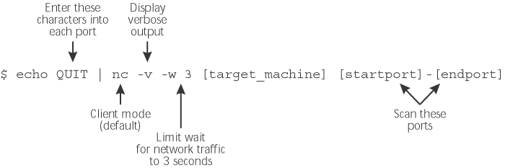
Netcat for Port Scanning
Note: verbose option will cause Netcat to display a list of open ports on target machine

Slide 101
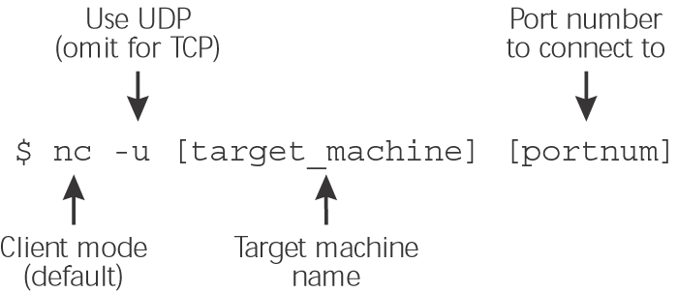
Connecting to Open UDP and TCP Ports via Netcat

Slide 102
Vulnerability Scanning using Netcat
Finds RPC vulnerabilities
Finds NFS exports whose file systems can be viewed by everyone
finds machines with weak trust relationship
Finds machines with very weak passwords
Finds buggy FTP servers
Vulnerability scanning is limited compared to Nessus

Slide 103
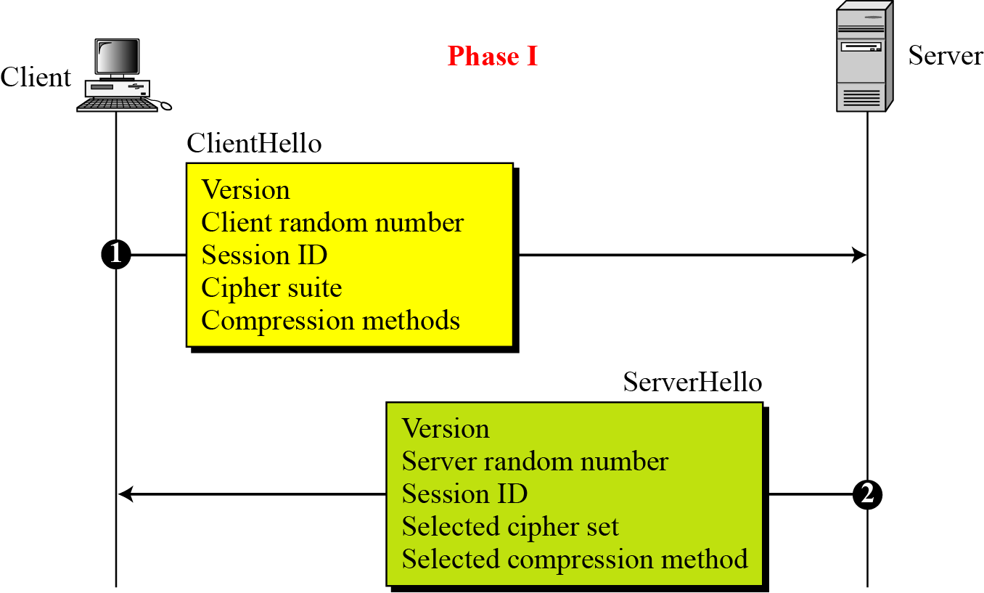
Phase 1

Slide 104
After Phase I, the client and server know the following:
The version of SSL
The algorithms for key exchange, message authentication, and encryption
The compression method
The two random numbers for key generation

Slide 105
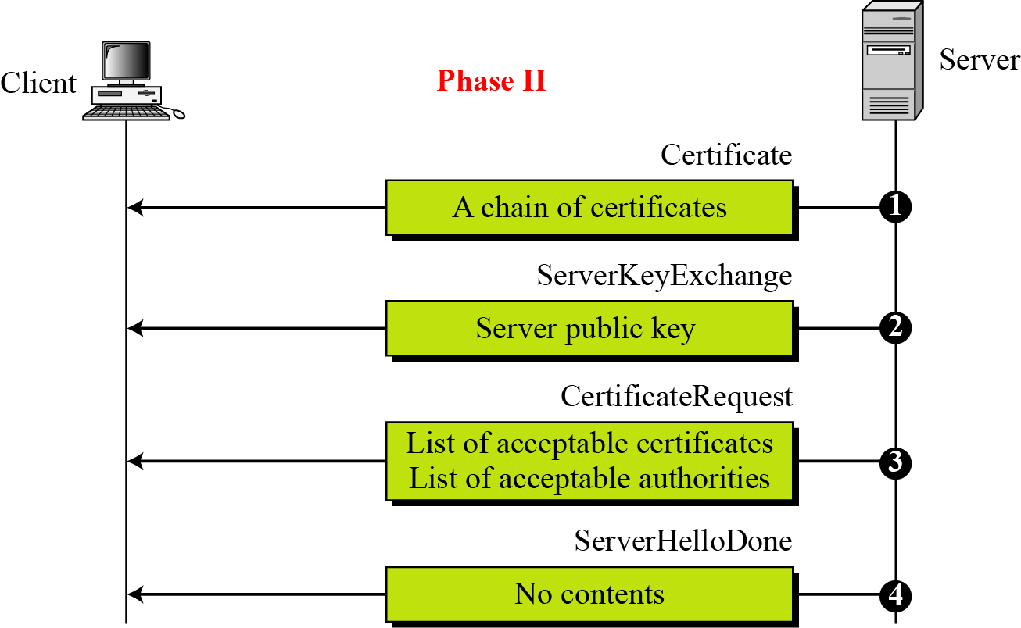
Phase 2

Slide 106
After Phase II:
The server is authenticated to the client.
The client knows the public key of the server if required.
After Phase III:
The client is authenticated for the server.
Both the client and the server know the pre-master secret.
After Phase IV:
The client and server are ready to exchange data.

Slide 107
TLS (Transport Layer Security)
IETF standard RFC 2246 similar to SSLv3 with minor differences
in record format version number
uses HMAC for MAC
a pseudo-random function expands secrets
has additional alert codes
some changes in supported ciphers
changes in certificate negotiations
changes in use of padding

Slide 108
Simple DoS
The Attacker usually spoofed
source address to hide origin
Easy to block
Attacker
Victim
Victim
Victim

Slide 109
Coordinated DoS
Attacker
Attacker
Attacker
Victim
Victim
Victim
The first attacker attacks a different victim to cover up the real attack
The Attacker usually spoofed source address to hide origin
Harder to deal with

Slide 110
Distributed DoS
Attacker
Handler
Handler
Agent
Agent
Agent
Agent
Agent
Victim

Slide 111
Distributed DoS
The handlers are usually very high volume servers
Easy to hide the attack packets
The agents are usually home users with DSL/Cable
Already infected and the agent installed
Very difficult to track down the attacker
How to differentiate between DDoS and Flash Crowd?
Flash Crowd → Many clients using a service legimitaly
Slashdot Effect
Victoria Secret Webcast
Generally the flash crowd disappears when the network is flooded
Sources in flash crowd are clustered

Slide 112
DoS Attack: Echo-Chargen

Slide 113
DoS Attack: Teardrop Attack
Notes:
The attacker sends packets that cannot possibly be reassembled (conflicting reassembly instructions). In extreme cases, this can cause the entire OS to lock up.

Slide 114
Firewalls
Lots of vulnerabilities on hosts in network
Users don’t keep systems up to date
Lots of patches
Lots of exploits in wild (no patch for them)
Solution?
Limit access to the network
Put firewalls across the perimeter of the network

Slide 115
Firewalls (contd…)
Firewall inspects traffic through it
Allows traffic specified in the policy
Drops everything else
Two Types
Packet Filters, Proxies
Internal Network
Firewall
Internet

Slide 116
Packet Filters
Packet filter selectively passes packets from one network interface to another
Usually done within a router between external and internal networks
screening router
Can be done by a dedicated network element
packet filtering bridge
harder to detect and attack than screening routers

Slide 117
Packet Filters Contd.
Data Available
IP source and destination addresses
Transport protocol (TCP, UDP, or ICMP)
TCP/UDP source and destination ports
ICMP message type
Packet options (Fragment Size etc.)
Actions Available
Allow the packet to go through
Drop the packet (Notify Sender/Drop Silently)
Alter the packet (NAT?)
Log information about the packet

Slide 118
Packet Filters Contd.
Example filters
Block all packets from outside except for SMTP servers
Block all traffic to a list of domains
Block all connections from a specified domain

Slide 119
Typical Firewall Configuration
Internal hosts can access DMZ and Internet
External hosts can access DMZ only, not Intranet
DMZ hosts can access Internet only
Advantages?
If a service gets compromised in DMZ it cannot affect internal hosts
A DMZ (demilitarized Zone) is a conceptual network design where publicly accessible servers are placed on a separate, isolated network segment.
The intention of a DMZ is to ensure that publicly accessible servers cannot contact other internal network segments, in the event that a server is compromised.
Internet
DMZ
X
X
Intranet

Slide 120
Example Firewall Rules
Stateless packet filtering firewall
Rule → (Condition, Action)
Rules are processed in top-down order
If a condition satisfied – action is taken

Slide 121


Stateful Firewall Example
Allow only requested TCP connections:
76.120.54.101
SYN
Seq = x
Port=80
Server
128.34.78.55
Client
SYN-ACK
Seq = y
Ack = x + 1
ACK
Seq = x + 1
Ack = y + 1
Trusted internal
network
(blocked)
SYN-ACK
Seq = y
Port=80
Attacker
Allow outbound TCP sessions,
destination port=80
Firewall
Established TCP session:
(128.34.78.55, 76.120.54.101)
Firewall state table

Slide 122
Sample Firewall Rule
Allow SSH from external hosts to internal hosts
Two rules
Inbound and outbound
How to know a packet is for SSH?
Inbound: src-port>1023, dst-port=22
Outbound: src-port=22, dst-port>1023
Protocol=TCP
Client
Server
SYN
SYN/ACK
ACK
Rule
Dir
Src Addr
Src Port
Dst Addr
Dst Port
Proto
Ack Set?
Action
SSH-1
In
Ext
> 1023
Int
22
TCP
Any
Allow
SSH-2
Out
Int
22
Ext
> 1023
TCP
Yes
Alow

Slide 123
Default Firewall Rules
Egress Filtering
Outbound traffic from external address → Drop
Benefits?
Ingress Filtering
Inbound Traffic from internal address → Drop
Benefits?
Default Deny
Why?
Rule
Dir
Src Addr
Src Port
Dst Addr
Dst Port
Proto
Ack Set?
Action
Egress
Out
Ext
Any
Ext
Any
Any
Any
Deny
Ingress
In
Int
Any
Int
Any
Any
Any
Deny
Default
Any
Any
Any
Any
Any
Any
Any
Deny

Slide 124
Stateless packet filtering
Should arriving packet be allowed in? Departing packet let out?
Internal network connected to internet via router firewall
Router filters packet-by-packet, decision to forward/drop packet based on:
Source IP address, destination IP address
TCP/UDP source and destination port numbers
ICMP message type
TCP SYN and ACK bits

Slide 125
Stateless Packet Filtering
Policy | Firewall Setting
No outside Web access. | Drop all outgoing packets to any IP address, port 80
No incoming TCP connections, except those for institution’s public Web server only. | Drop all incoming TCP SYN packets to any IP except 130.207.244.203, port 80
Prevent Web-radios from eating up the available bandwidth. | Drop all incoming UDP packets - except DNS and router broadcasts.
Prevent your network from being used for a smurf DoS attack. | Drop all ICMP packets going to a “broadcast” address (eg 130.207.255.255).
Prevent your network from being tracerouted | Drop all outgoing ICMP TTL expired traffic

Slide 126
Packet Filters
Advantages
Transparent to application/user
Simple packet filters can be efficient
Disadvantages
Usually fail open
Very hard to configure the rules
Doesn’t have enough information to take actions
Does port 22 always mean SSH?
Who is the user accessing the SSH?

Slide 127
Alternatives
Stateful packet filters
Keep the connection states
Easier to specify rules
More popular
Problems?
State explosion
State for UDP/ICMP?

Slide 128
Alternatives
Proxy Firewalls
Two connections instead of one
Either at transport level
SOCKS proxy
Or at application level
HTTP proxy
Requires applications (or dynamically linked libraries) to be modified to use the proxy

Slide 129
Proxy Firewall
Data Available
Application level information
User information
Advantages?
Better policy enforcement
Better logging
Fail closed
Disadvantages?
Doesn’t perform as well
One proxy for each application
Client modification

Slide 130
Intrusion detection systems
Packet filtering:
Operates on TCP/IP headers only
No correlation check among sessions
IDS: intrusion detection system
Deep packet inspection: look at packet contents (e.g., Check character strings in packet against database of known virus, attack strings)
Examine correlation among multiple packets
Port scanning
Network mapping
Dos attack

Slide 131
Intrusion detection systems
multiple IDSs: different types of checking at different locations
application
gateway
firewall
Internet
internal
network
Web
server
IDS
sensors
DNS
server
FTP
server
demilitarized
zone

Slide 132
Intrusion Detection Systems
Firewalls allow traffic only to legitimate hosts and services
Traffic to the legitimate hosts/services can have attacks
CodeReds on IIS
Solution?
Intrusion Detection Systems
Monitor data and behavior
Report when identify attacks

Slide 133

Types of IDS
Signature-based
Anomaly-based
Host-based
Network-based

Slide 134

Network-based IDS
Characteristics
NIDS examine raw packets in the network passively and triggers alerts
Advantages?
Easy deployment
Unobtrusive
Difficult to evade if done at low level of network operation
Disadvantages?
Fail Open
Different hosts process packets differently
NIDS needs to create traffic seen at the end host
Need to have the complete network topology and complete host behavior

Slide 135

Host-based IDS
Characteristics
Runs on single host
Can analyze audit-trails, logs, integrity of files and directories, etc.
Advantages
More accurate than NIDS
Less volume of traffic so less overhead
Disadvantages
Deployment is expensive
What happens when host get compromised?

Slide 136
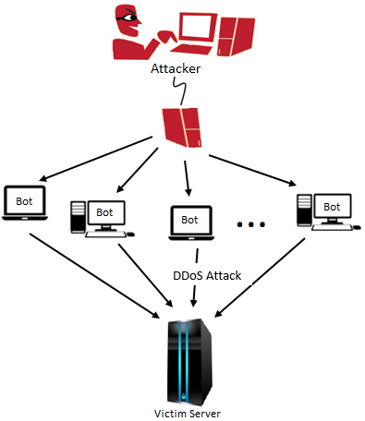
Bots - Introduction
Bot is an automated malicious program installed on a vulnerable machine for carrying some illicit task over a network.
Botnet is a collection of large number of such infected machines which coordinate with each other and are under the remote control of an attacker via Command and Control (C&C) channels.
Botnets are used for various criminal activities as: DDoS attacks, click frauds.

Slide 137
Botnet Command and Control (C&C) Mechanism
Centralized
Pros - easy to setup, fast commands dissemination
Cons - easy to detect , single point of failure
IRC and HTTP protocol based attacks
Peer-to-Peer (P2P) Topology
Pros – decentralized, not easy to detect, not single point of failure
Cons – not easy to setup (more complex), message delivery not guaranteed and high latency
Overnet (Parasite – Malicious and Benign both)
Stormnet (Bot only / No benign peers)

Slide 138
Botnet Command and Control (C&C) Mechanism
Push Based
Centralized
HTTP Based
P2P Based – Broadcast command file
Bot receivers will only respond
Pull Based – Bot will poke periodically its neighboring peers say searching for a particular key for command updates from attacker
Key could be fresh each time
e.g. Storm / IRC

Slide 139
Botnet Classification Command & Control (C&C)
IRC Based – C&C using IRC Server
HTTP Based – C&C using Web Server
DNS Based – C&C use Fast-flux networks
P2P Based – C&C on peer-to-peer protocol

Slide 140
Internet Relay Chat IRC Protocol
IRC mainly designed for one to many conversations but can also handle one to one
Most corporate networks do not allow IRC traffic so any IRC requests can determine and external or internal bot
Outbound IRC - an already infected computer on the network
Inbound IRC - a network computer is being recruited

Slide 141
HTTP Protocol
Due to prevalence of HTTP usage it is harder to track a botnet that uses HTTP Protocols
Using HTTP can allow a botnet to skirt the firewall restrictions that hamper IRC botnet
Detecting HTTP botnet is harder but not impossible since the header fields and the payload do not match normal HTTP traffic
Some new options emerging are IM and P2P protocols and expect growth in the future

Slide 142
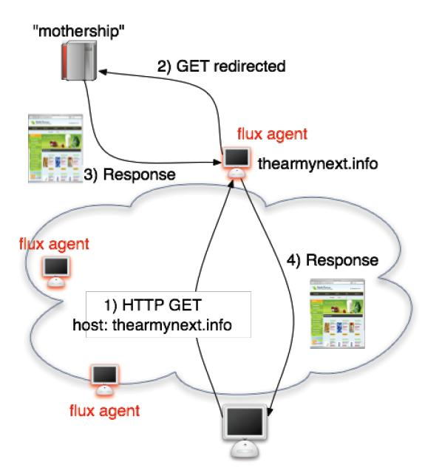
HTTP Botnet Example Fast-flux Networks
Commonly used scheme
Used to control botnets any number of nodes

Slide 143
Command and Control (C&C)
Weakest link of centralized botnet
Elimination of botmaster takes out the botnet
High level of activity by botmaster makes them easier to detect than their bots

Slide 144
P2P Networks
Structured
Pros - Easy Localization
Kademlia DHT based networks
Unstructured Topology – extreme peer to peer topology, one to one communication
Pros – easy to setup, decentralized, not easy to detect, not single point of failure
Cons –message delivery not guaranteed and high latency (flooding)
Napster, BitTorrent, Gnutella, FastTrack/KaZaA, eMule, and Freenet.

Slide 145
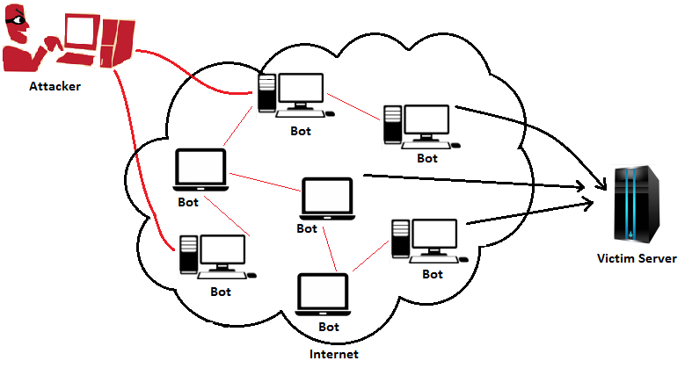
P2P Botnets
Bots in P2P botnets act as both client and C&C server.
Botmaster injects commands to one or several bots, which then has to be disseminated to the whole botnet via C&C channels.
Advantage:
If a bot or a part of P2P botnet gets identified and is taken down, even then, communication in rest of the botnet will not be disrupted.
In Q1 2015, 23095 botnet-assisted DDoS attacks were reported

Slide 146
Linux-based botnets (Kaspersky: Securelist.com)
Although there are far fewer Linux-based botnets, the number of attacks launched from them is larger than that of the attacks launched from Windows-based botnets; also, the attacks from Linux-based botnets are more powerful.
This is because a successful infection of a Linux-based server provides the cybercriminals with vast opportunities to manipulate network protocols.
In addition, infected servers typically have faster internet connections than individual computers, so more powerful attacks can be carried out.
Besides, Linux-based botnets have much longer lives than Window-based botnets do. This is because Linux-based botnets are more difficult to detect and deactivate, since Linux servers are much less likely than Windows-based servers /devices to be equipped with dedicated security solutions.

Slide 147
Bot Attack Strategy
Recruitment of the agent network
Finding vulnerable systems
Breaking into vulnerable systems
Protocol attack
Middleware attack
Application or resource attack
Controlling the agent network
Direct, Indirect commands
Updating malware
Unwitting agents

Slide 148
Storm Botnet
Storm marked its presence in 2007 (Centralized)
In 2007, accounted for 8% of malware infections globally
Started with mainly Emails
Estimated size: approx. 5 million
Peer-to-Peer i.e. Decentralized:
Peacomm (Symantec), Peed and Tibs (BitDefender)
Zhelatin (F-Secure and Kaspersky)
W32.Waledac.B

Slide 149
W32.Waledac.B
A worm that spreads by sending emails that contain links to copies of itself. It also sends spam, downloads other threats, and operates as part of a botnet.
The threat is spammed through email as holiday greeting cards. The email contains a link to a website that hosts the worm.
Worm creates following registry entry so that it runs every time Windows starts:
HKEY_LOCAL_MACHINE\SOFTWARE\Microsoft\Windows\CurrentVersion\Run\"SmartIndex" = "[PATH TO WORM]“
The worm then opens a back door on the compromised computer on TCP port 80 and UDP port 445.
The worm may end certain processes. It then attempts to download updates of itself from the URL: http://[IP ADDRESS]/flash3.exe
It may also download other executable files.
The worm sends the following spam emails with a link that leads to a malicious file, which is usually a copy of itself.
Source- http://www.symantec.com/

Slide 150
Classification of Botnet Detection Methods
Detection techniques are classified according to the approach they are implementing for botnet detection.
Mainly, we have two types of detection techniques:
(i) Honeynet-based, and
(ii) Intrusion Detection Systems (IDS).
In case of Honeynet-based techniques, honeypots are made to become part of the botnet and then the behaviour of that system is analysed to know about the structure of the botnet.
IDS on the other hand consists of techniques, which work by studying behaviour of botnets either for any kind of anomaly or to check if that behaviour belongs to any already known botnet.
Thus, IDS can be further categorised as Signature-based and Anomaly-based detection systems.
Anomalies to be exploited for detection can be in infected host and/ or in the network being exploited by botnet.

Slide 151
Background: P2P Systems
Host-based overlay system
Structured and unstructured
Rich connectivity
Very popular
– 3,467,860 users in the FastTrack P2P system;
– 1,420,399 users in the eDonkey P2P system;
– 1,155,953 users in the iMesh P2P system;
– 103,466 users in the Gnutella P2P system.

Slide 152
Modeling P2P-based Active Worm Attacks
Basic worm attack strategies
Pure Random-based Scan (PRS)
Randomly select the attack victim (IP address from global space) to launch the worm attack
Infected hosts do not have any prior vulnerability knowledge or active/ inactive information of other hosts.
When the new host is infected, it continuously attacks the system by using the same methodology.
Adopted by Code-Red-I and Slammer
P2P based attack strategies
Offline P2P-based Hit-list Scan (OPHLS)
Online P2P-based Scan (OPS)
Both strategies exploit P2P system features

Slide 153
Two P2P-based Worm Attack Strategies
Offline P2P-based Hit-list Scan (OPHLS)
Offline collect P2P host addresses as a hit-list
Attack the hit-list first
Attack Internet via PRS
Online P2P-based Scan (OPS)
Use runtime P2P neighbor information
Attack P2P neighbors
Extra attack resource applied to attack Internet via PRS

Slide 154
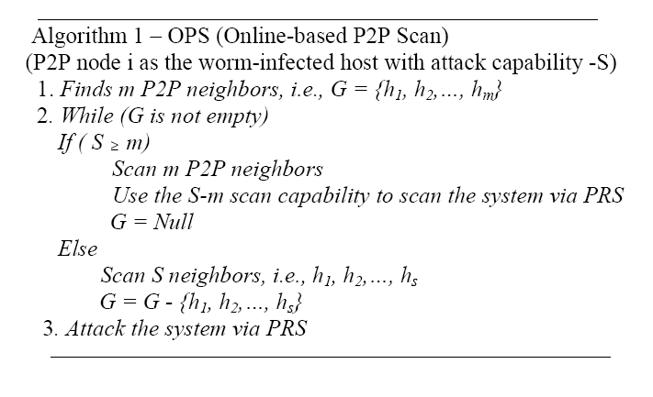
Online-based P2P Worm Attack Strategy

Slide 155
Performance Comparison of Attack Strategies
The P2P-based attack strategies overall outperforms the PRS attack strategy
OPHLS attack strategy achieves the best performance compared to all other online-based attack strategies

Slide 156
Propagation Methods for Recruiting Bots
Social engineering: Storm binary gets installed on a system if user clicks links such as those for greeting cards, video games or links to “important news of the day". E.g. email spamming
Driver-by download: Binary gets installed when an user visits a website which exploits vulnerabilities of the user's web browser or its add-ons

Slide 157
Binary installation in Storm
The binary performs an XOR decryption consisting of an anti-sandbox trick and is done to crash antivirus emulator engines, to avoid detection followed by modifications to system drivers (e.g. through methods such as rootkit / registry changes).
The binary is then decrypted and installed.
On successful installation, infected host is synchronized using NTP.
The binary contains a text file: spooldr.ini which contains 300 hosts addresses currently known to the trojan.
Size of the spooldr.ini text file increases as the host comes to know about other peers.

Slide 158
Botnet Taxonomy
Things required to identify, detect, and mitigate the risk of an attack.
Attacking Behavior
C&C Models
Rally Mechanisms (Waiting stage)
Communication Protocols
Observable botnet activities
Evasion Techniques

Slide 159
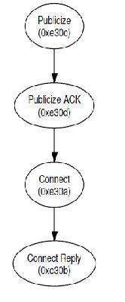
Connectivity
The host sends eDonkey publicize packets to the hosts specified in the spooldr.ini.
On receiving Publicize ACK (0xe30d) from live peers, Connect requests (0xe30a) are sent to them for up-to-date information of the P2P network, they have.
Publicize and Connect packets are consistently sent to any and all peers throughout the life of the infected host.

Slide 160
Updates
All host and files shared were assigned unique 128-bit identifiers, used to locate them.
Nodes uses publish packets (0xe313) for advertising the files they are having.
Bots updates themselves with a two-tier process
UDP P2P communications
TCP sessions

Slide 161
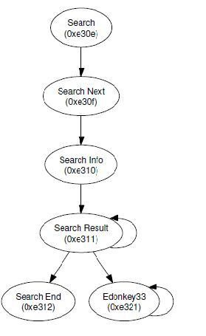
Updates (continued…)
UDP On reaching a steady state of the network, search packets (0xe30e) with specific keys are sent out periodically by the infected hosts.
eDonkey protocol is used only for management purpose which consists of publicize, connect and search packets, i.e., UDP packets.
TCP sessions:
Once the required command file’s location or host is identified, TCP connection are initiated with the hosts for downloading the required command file.

Slide 162
Botnet Detection
Detection of bots is difficult due to:
Decentralized Architecture
Encryption/ encrypted traffic
Continuously changing communication architecture and Ports
Occasional Abnormal Behaviour of Users
Detection of bots not involved in any malicious activity
Deep packet inspection need
Unknown P2P botnets/unknown protocol being used

Slide 163
Botnet Detection
Honeypot Based
Signature Based – able to detect only known bots
Anomaly Based – detect bots based traffic anomalies
DNS Based – detect based DNS information
Mining Based – detect based machine learning, classification and clustering

Slide 164
Honeypot-Aware Botnet
Honeypot is widely used by defenders
Ability to detect unknown attacks
Ability to monitor attacker actions (e.g., botnet C&C)
Attacker should not be able to find out the presence of Honeypot
bot
1 malicious traffic
Honeypot (secret)
3 Authorize
2 Inform bot’s IP
C&C

Slide 165
Defense against Honeypot-Aware Attacks
Permit dedicated honeypot detection systems to send out malicious traffic
Need law and strict policy
Figure out what outgoing traffic is for honeypot detection, and then allow it
It could be very hard
Detection based on fundamental difference
Honeypot defenders are liable for attacks sending out
Liability law will become mature
Real attackers bear no liability

Slide 166
Anomaly Based Detection
Detect based on traffic anomalies such as
High Network Latency
High Volumes of Traffic
Traffic on unusual ports
Unusual System Behaviour
Major Advantage
Solve the unknown bots

Slide 167
Botnet Traffic Analysis with Wireshark
Wireshark is a free and open-source packet analyser.
Data can be captured "from the wire" from a live network connection or read from a file of already-captured packets.
Live data can be read from different types of networks including Ethernet, IEEE 802.11, PPP, and loopback.
Captured network data can be browsed via a GUI, or via the terminal (command line) version of the utility, Tshark.
Captured files can be programmatically edited or converted via command-line switches to the "editcap" program.
Data display can be refined using a display filter.

Slide 168
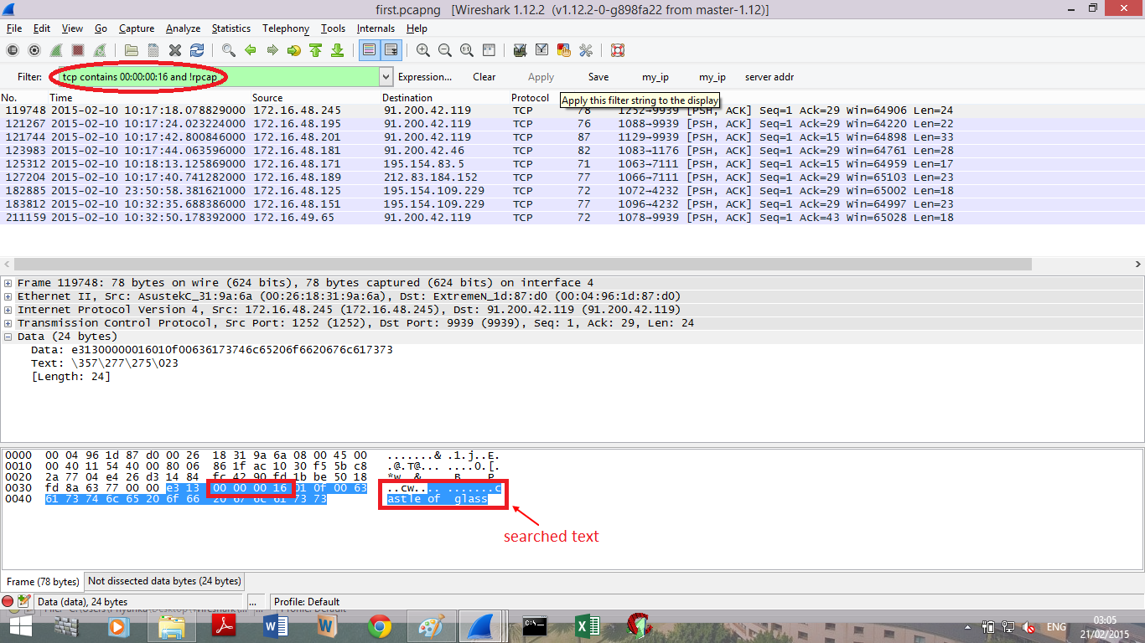

Slide 169
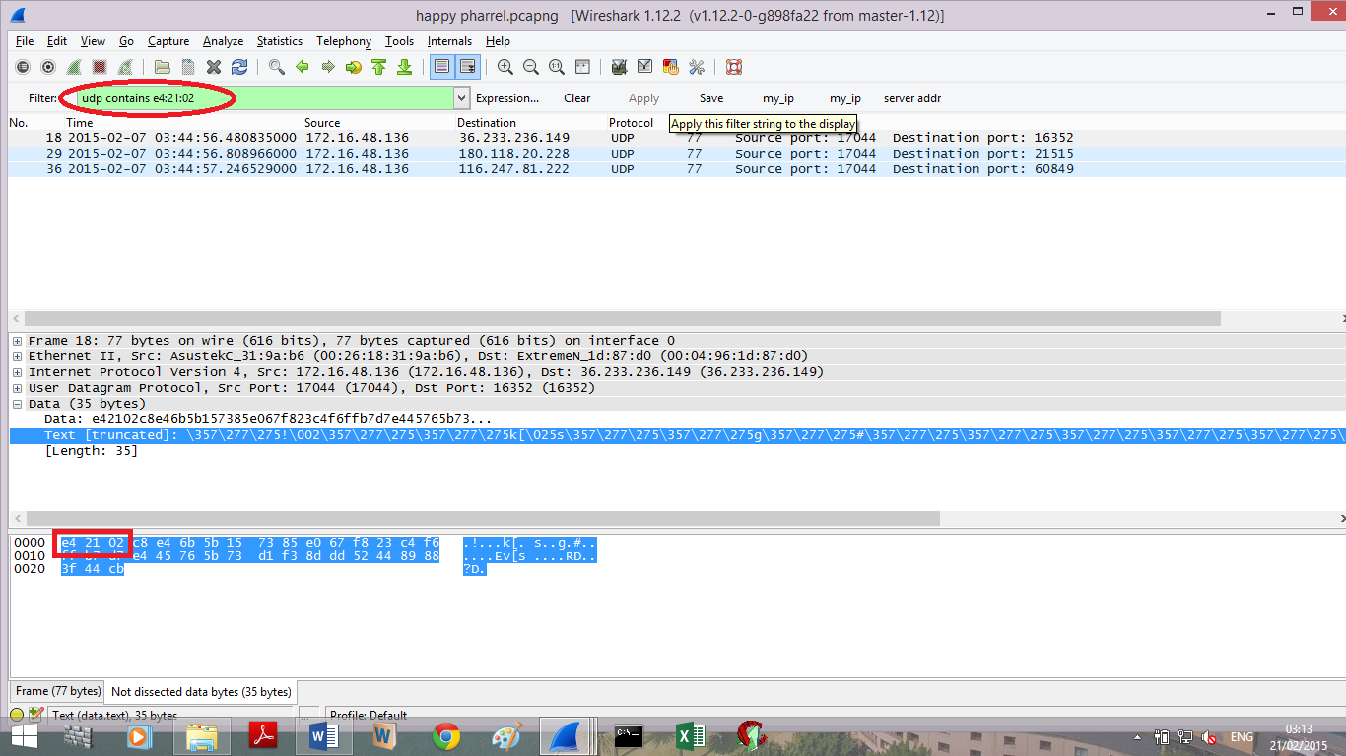

Slide 170
